Slide 1


KVJ MŰVEK
30 YEARS IN AUTOMOTIVE INDUSTRY
—
2025
WWW.KVJMUVEK.HU

Slide 2
30 YEARS IN AUTOMOTIVE INDUSTRY
30 YEARS IN AUTOMOTIVE INDUSTRY
2000
1994
WAGON R+
2003
IGNIS
The company was founded by Mr. Jenő V. Kiss started with manufacturing of part storage containers for automotive industry
2004
2012
2019
SWIFT
became the official supplier of Robert BOSCH GmbH
became the official supplier of Hybride VITARA and S-CROSS models
2006
SX4
became the official supplier of Hungarian Suzuki Corporation (MSC) with parts for SWIFT model
became the official supplier of parts for new VITARA model
became the official supplier of BWI Group
Joined to VIDEOTON Group
1995
2015
2006
2020
2013
became the official supplier of parts for VITARA and S-CROSS models

Slide 3
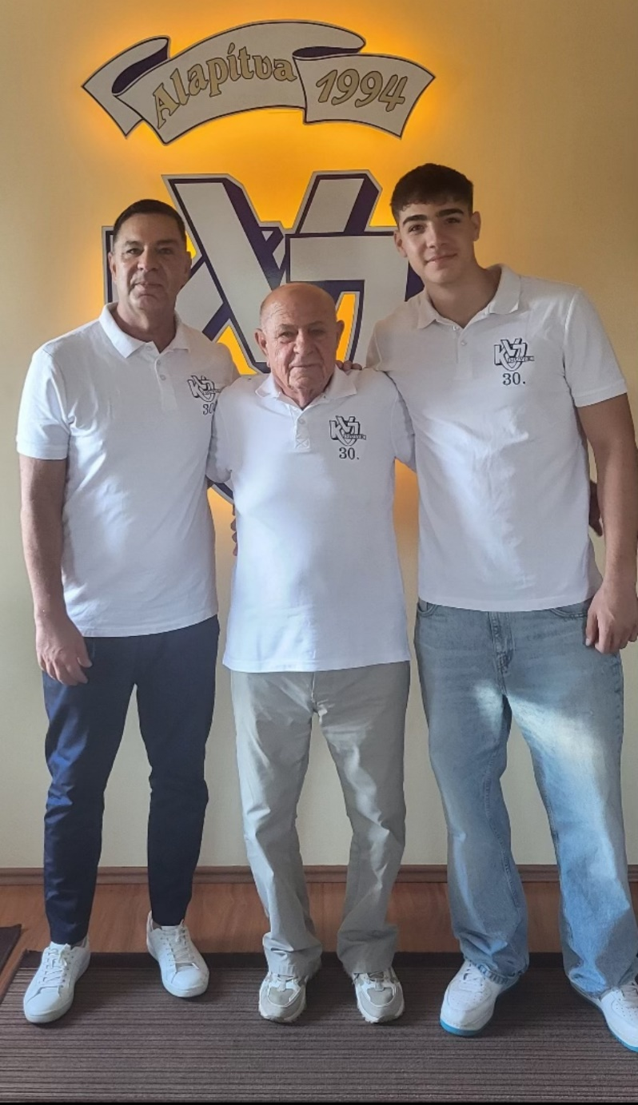
Family first！
30 YEARS IN AUTOMOTIVE INDUSTRY
Family is everything！ Three generations working together! On the photo you can see：
Kiss V. Jenő，The Founder
Dr. Kiss Norbert，The CEO
Kiss Benedek Norbert, Head of Business Development

Slide 4
HIGHLIGHTS OF KVJ
30 YEARS IN AUTOMOTIVE INDUSTRY
30+
11,5
Revenue
(2024)
150+
Active P/Ns
Years in automotive
Mill €
5000+
Raw material usage (tons)
23
Presses (100-630 t)
120
Employees*
(2024)

Slide 5
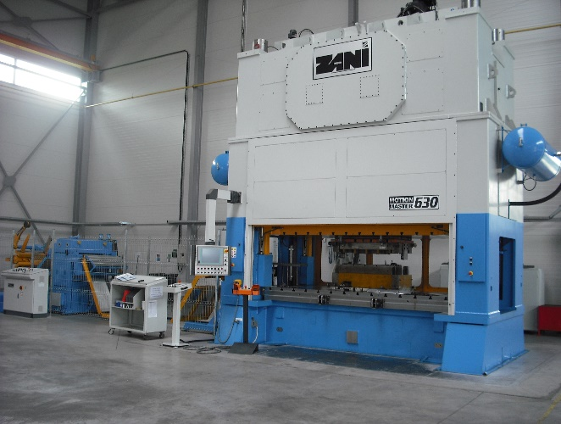
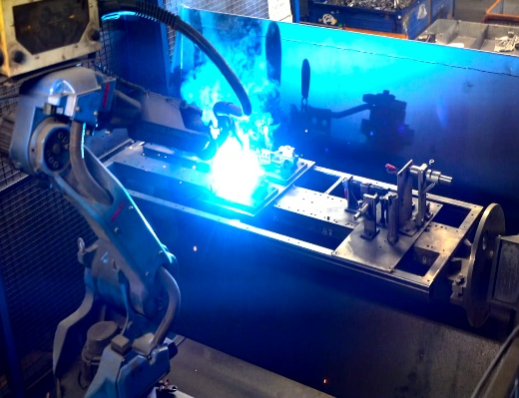
CORE TECHNOLOGIES
30 YEARS IN AUTOMOTIVE INDUSTRY
STAMPING
WELDING

Slide 6
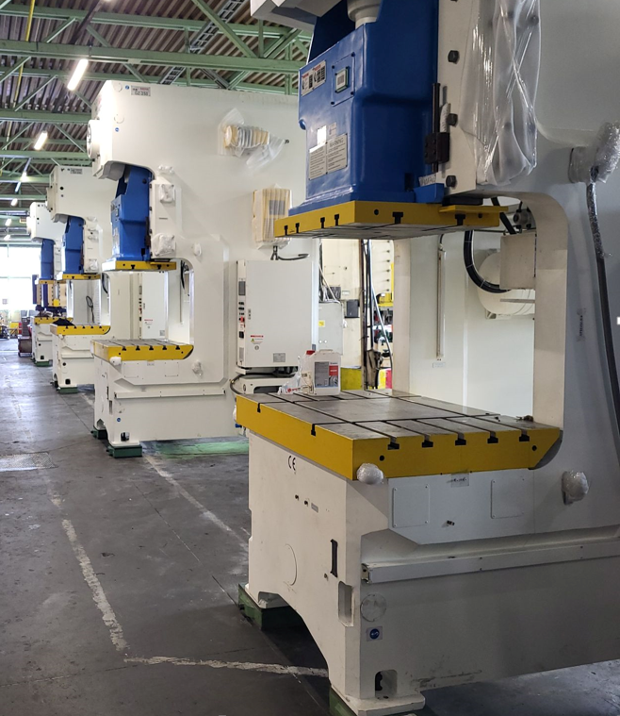
CORE TECHNOLOGIES
30 YEARS IN AUTOMOTIVE INDUSTRY
EXCENTRIC PRESSES
EXCENTRIC PRESSES

Slide 7
CORE TECHNOLOGIES
30 YEARS IN AUTOMOTIVE INDUSTRY
Pressing machines
Type | Quanity | Brand | Pressing force(kN) | Table size (mm x mm) | Ram size (mm x mm) | Stroke length (mm) | Die height (mm) | Height adjustment (mm)
Eccentric press machines with coil feeder | 1 | LEXN 100 E | 1000 | 1000 x 640 | 560 x 360 | 10 - 80 | 80 | 80
 | 1 | SANGIACOMO 250 E | 2500 | 1600 x 900 | 1100 x 750 | 15 - 220 | 520 | 100
 | 1 | SIMPAC MC2 | 2500 | 2400 x 1000 | 2100 x 800 | 250 | 550 | 200
 | 1 | SIMPAC MC2 | 3500 | 2700 x 1100 | 2600 x 1000 | 250 | 550 | 200
 | 1 | ZANI Motion Master | 6300 | 3500 x 1500 | 3420 x 1450 | 150 - 300 | 880 | 150
 | 1 | ISGEC 630 | 6300 | 3400 x 1300 | 3100 x 1200 | 350 | 880 | 120
Total: | 6
Eccentric press machines without coil feeder | 1 | LEXN 100 E | 1000 | 900 x 630 | 560 x 360 | 10 - 125 | 310 | 100
 | 3 | DIRINLER CDCS 150 E | 1500 | 1250 x 850 | 750 x 600 | 10 - 110 | 380 | 100
 | 2 | LEK 160 E | 1600 | 1000 x 740 | 1000 x 600 | 10 - 160 | 550 | 160
 | 4 | ISGEC 250 | 2500 | 1450 x 950 | 940 x 700 | 250 | 600 | 120
 | 2 | LEK 250 E | 2500 | 1160 x 850 | 1160 x 800 | 25 - 120 | 600 | 150
 | 2 | SANGIACOMO 250 E | 2500 | 1600 x 900 | 1100 x 750 | 15 - 220 | 520 | 100
Total: | 14
Hydraulic press machines | 1 | PYE 25 H | 250 | 500 x 500 | 250 x 250 | 0 - 420 | 600
 | 1 | PYE 63 H | 630 | 630 x 500 | 450 x 360 | 0 - 550 | 800
 | 1 | DIRINLER CDCH 160 H | 1600 | 1250 x 850 | 750 x 600 | 10 - 110 | 380
Total: | 3
Grand total: | 25

Slide 8
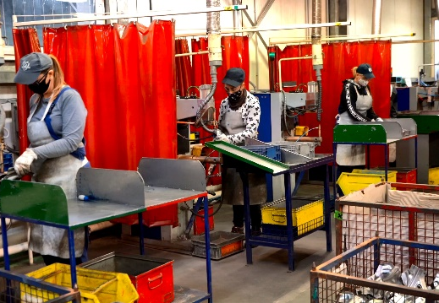
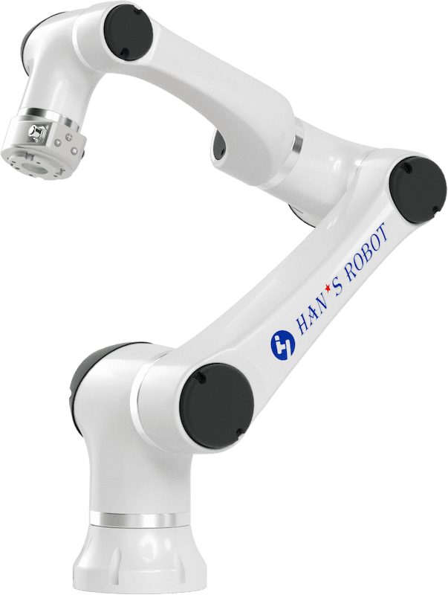
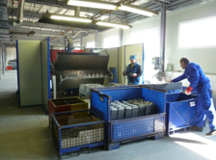
CORE TECHNOLOGIES
30 YEARS IN AUTOMOTIVE INDUSTRY
ARC WELDING
SPOT-WELDING
COBOTS
SPOT-WELDING ROBOTS

Slide 9
CORE TECHNOLOGIES
30 YEARS IN AUTOMOTIVE INDUSTRY
Welding machines
Technology | Quanity | Brand | Type | Stream control | Nominal power (kVA) | Maximum welding stream (kA) | Electrode force (daN)
MIG-welding | 3 | MOTOMAN | Robot (Rolling plate)
Total | 3
Spot-welding robot | 3 | PWXYZAC | Robot + mounted welding machine | yes (TECHNA 450) | 25 | 15 | 220
 | 1 | MOTOMAN | Robot + mounted welding machine | yes (TECHNA 450) | 25 | 15 | 220
 | 2 | FANUC S-420W | Robot + mounted welding machine | yes (TECHNA 450) | 50 | 21,5 | 300
Total | 6
Collaborative robot | 4 | Hans | Robot + mounted welding machine | yes
Total | 4
Spot-welding machine | 15 | PEI PF151 | Stage | yes (TECHNA 450) | 50 | 21,5 | 300
 | 1 | PEI PF151 | Stage | yes (MPS 300) | 50 | 21,5 | 300
 | 3 | PEI PF151 | Stage | no | 50 | 21,5 | 300
 | 1 | PEI PF161 | Stage | no | 60 | 26 | 300
 | 1 | PEI PF161 | Stage | yes (PX1500) | 60 | 26 | 350
 | 1 | AWL WP63RLK | Stage | yes (DTW521P-F) | 63 | 28 | 350
 | 1 | AEG Pb 5-1 | Stage |  | 60 | 22 | 350
Total | 23
Special welding machine | 2 | SOYER (BMK) | Inverter | yes
Total | 2
Grand total: | 38

Slide 10
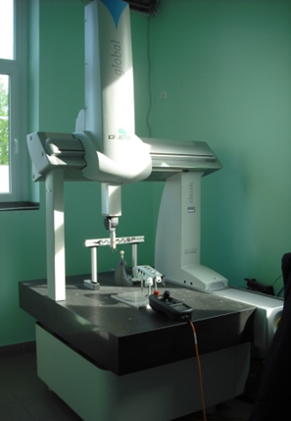
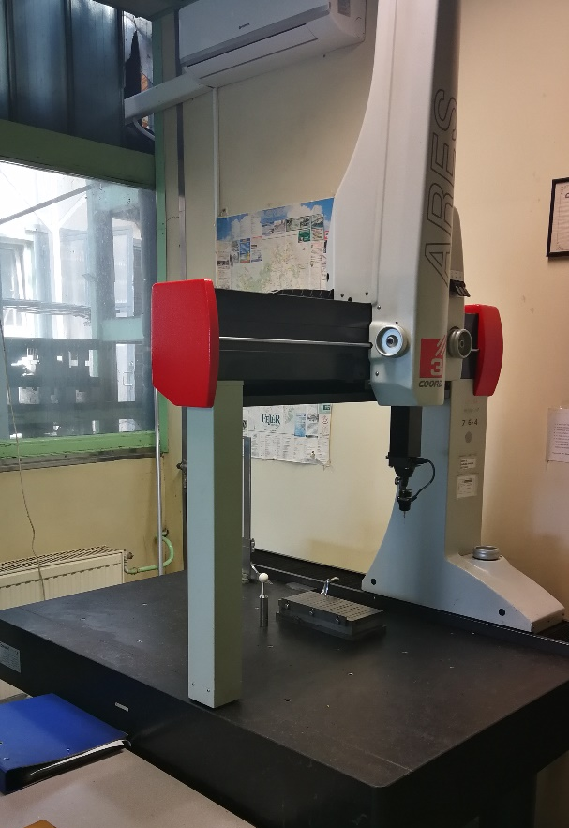
MEASUREMENT CAPABILITIES
30 YEARS IN AUTOMOTIVE INDUSTRY
DEA GLOBAL 7-7-5 CMM
ARES COORD 3D 7-6-4 CMM

Slide 11
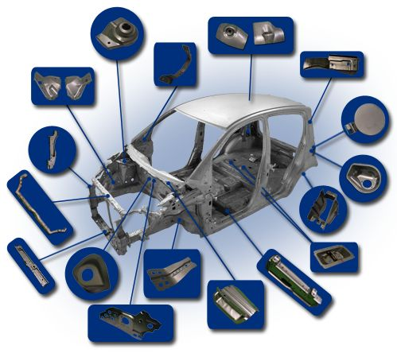
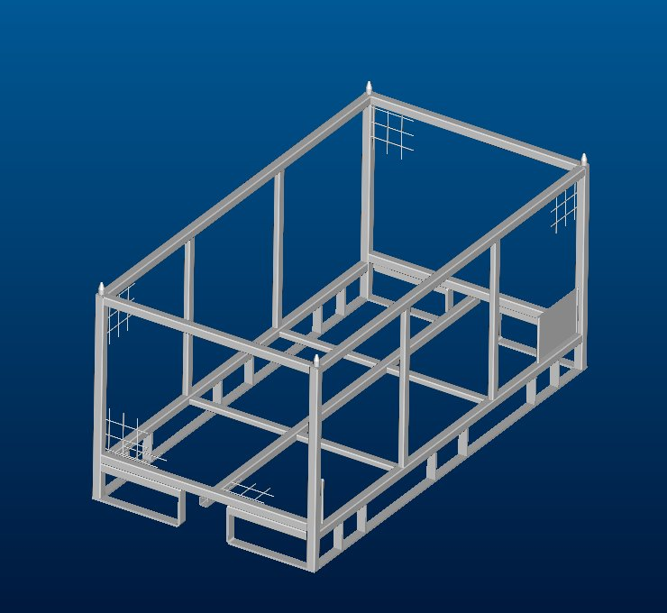
PORTFOLIO
30 YEARS IN AUTOMOTIVE INDUSTRY
PARTS PRODUCTION
CUSTOM STORING UNITS

Slide 12

PORTFOLIO
30 YEARS IN AUTOMOTIVE INDUSTRY

Slide 13
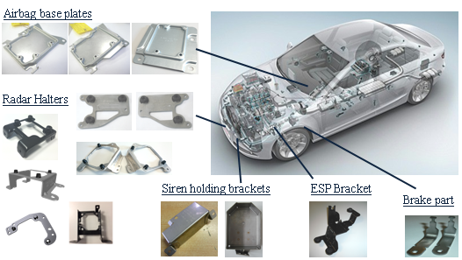

PORTFOLIO
30 YEARS IN AUTOMOTIVE INDUSTRY

Slide 14
SALES OF AUTOMATIVE PARTS
30 YEARS IN AUTOMOTIVE INDUSTRY
Capacity Growth and Efficiency
As a result of our developments, production capacity and efficiency have been increasing steadily year over year.
Our current capacity is sufficient to fulfill nearly twice the current order volume.
SALES OF AUTOMATIVE PARTS (Million pcs)

Slide 15




RAW MATERIAL USE ~5 000 t / YEAR
30 YEARS IN AUTOMOTIVE INDUSTRY
Hot- and cold-rolled, coated, non-coated, stainless steel, high-strength steel and alumina-alloys (e.g.AlMg3)
—
WITHOUT COATING
DC03AN, DC04, DD13, HC360L, HC380LA, HCT600X, S235JRG2, DP600
COATED:
+Z100 or +ZF100: DX53D, DX54D, DX56D, DP600, H340LAD, HCT600X
+Z140 MBC: DX54D

Slide 16
Custom storing and delivering units
30 YEARS IN AUTOMOTIVE INDUSTRY

Slide 17
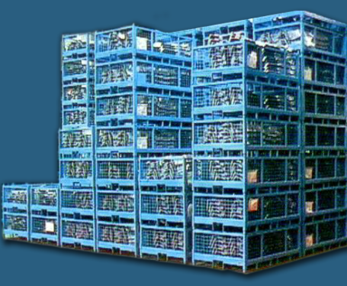
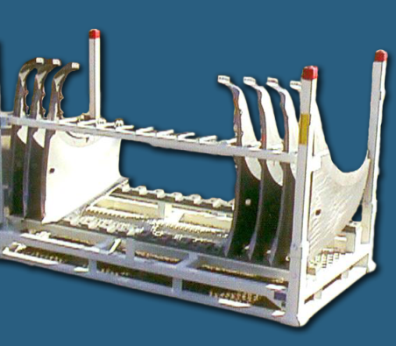
Key benefits
30 YEARS IN AUTOMOTIVE INDUSTRY
All racks can be custom-made to specifications.
These containers are specially developed storage containers suitable for the storage and transport of various industrial components.
They can be fitted into one another both in open and closed states, allowing for optimized space utilization.
The containers can be handled by a forklift and ensure that the elements are not damaged during either transport or storage.

Slide 18
Process workflow
30 YEARS IN AUTOMOTIVE INDUSTRY
Consulting:
-Cost reduction
-Optimization -DMU simulation
RFQ CAD Modell or real example
Product development
Original CAD models will be used for the packaging design. This allow high value simulation and problem solution
Prototype
Mass production:
Steel parts packaging
Plastic parts packaging
Returnable packaging

Slide 19
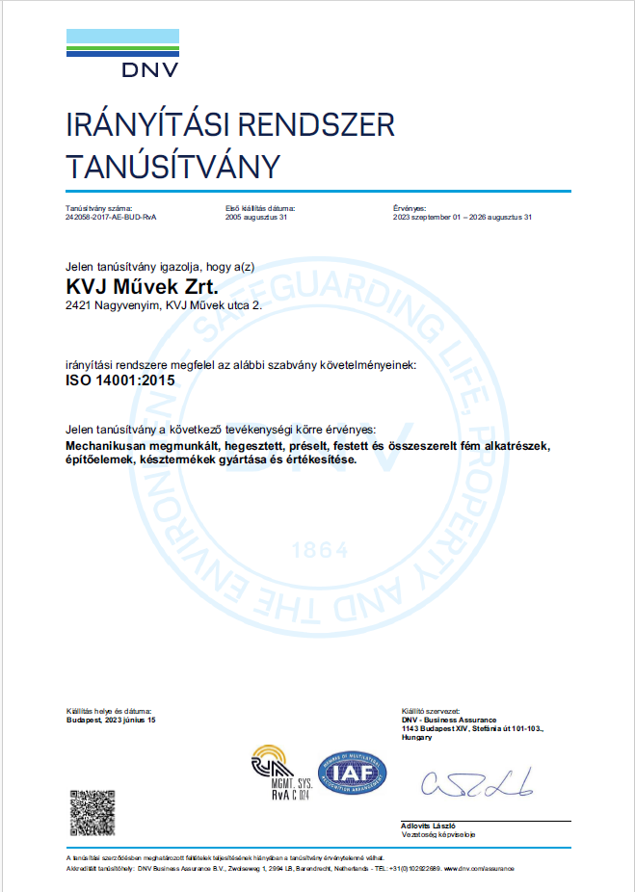
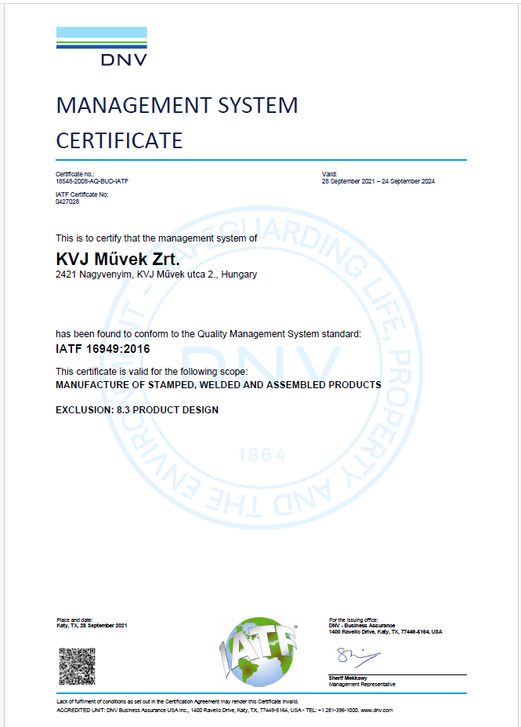
QUALITY MANAGEMENT SYSTEM
30 YEARS IN AUTOMOTIVE INDUSTRY
Manufacturing according to ISO certifications:
—
ISO 9002:1994 (1996-2002)
ISO 9001:2000 (2002-2008)
ISO 14001:2004 (since 2005)
ISO/TS 16949:2009 (since 2004)
IATF 16949 (since 2018)

Slide 20
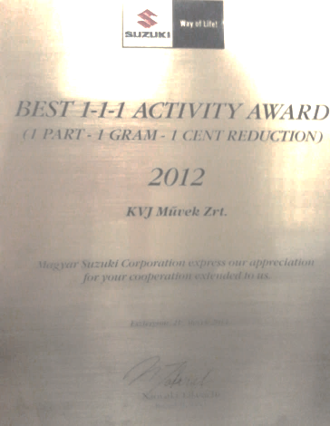
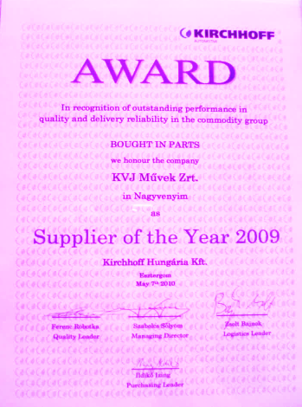
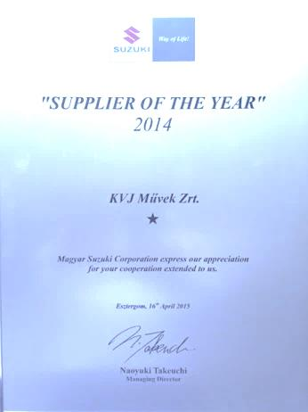
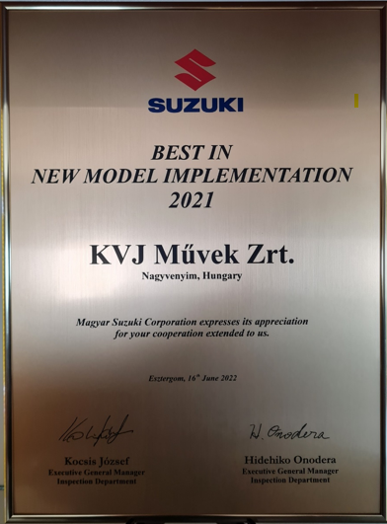
Awards
30 YEARS IN AUTOMOTIVE INDUSTRY
Awards:
—
2009: Supplier of the Year
KIRCHHOFF Hungária Kft.
2012: Best 1-1-1 Activity Award of Year
HUNGARIAN SUZUKI CORP.
2014: Supplier of the Year
HUNGARIAN SUZUKI CORP.
2021: Best in new model implementation
HUNGARIAN SUZUKI CORP.

Slide 21












REFERENCES
30 YEARS IN AUTOMOTIVE INDUSTRY

Slide 22

























REFERENCES
30 YEARS IN AUTOMOTIVE INDUSTRY

Slide 23

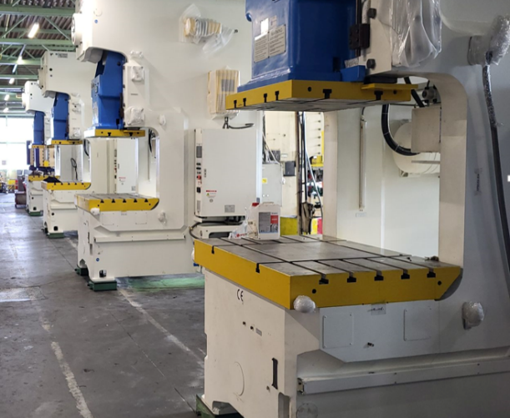
GALERY
30 YEARS IN AUTOMOTIVE INDUSTRY
Watch a short movie about our plant:
https://youtu.be/ZOHernOm5fw

Slide 24


THANK YOU FOR YOUR ATTENTION!
30 YEARS IN AUTOMOTIVE INDUSTRY
„Coming together is a beginning;
keeping together is progress;
working together is success.”
Henry Ford
Fazekas Zsanett
KVJ Művek Zrt.
Operative Management
Tel.: +36 30 348 7078
zs.fazekas@kvjmuvek.hu
Norbert Benedek Kiss (Mr)
KVJ Művek Zrt.
Head of Business Development
Tel.: +36 30 466 6912 b.kiss@kvjmuvek.hu
www.kvjmuvek.hu

